Slide 1

Vehicle Monitoring System Based on Mobile Devices
Student:
BSE173
Roytman Sergey
Supervisor:
Department of Software Engineering Hadi Saleh
Higher School of Economics, Moscow, 2021
www.hse.ru
Notes:
Good morning ladies and gentlemen. I’d like to quickly introduce myself. My name is Sergey Roytman, my academic advisor name is Hadi Saleh Muhhamed. And a theme of my diploma is Vehicle Monitoring System Based on Mobile Devices

Slide 2

Subject field description
Vehicle Monitoring Systems
Applications
State sector:
Public transport
Garbage trucks
…
Private sector:
Delivery
Taxi
…
Notes:
Vehicle monitoring systems are widely used in state and private sectors.
That kind of systems is suitable for fleet management, in particular management of delivery trucks, taxi services, public transport, garbage trucks or business trips controlling
Commonly such systems are used for monitoring vehicle location and operational statistics, observe driver’s productivity, detecting motor vehicle collisions and thefts.

Slide 3
Basic definitions
Term | Definition
GPS tracker | Hardware device, which connects to the vehicle on-board software in order to obtain and send to the server all desired information about the vehicle state, using mobile network
фото
фото
фото
Notes:
One of the basic definition used in this presentation is GPS tracker… GPS tracker is a

Slide 4
Relevance of the topic
фото
«GrandViewSearch»: world average growth rate will be 14% yearly from 2020 to 2027
Non-commercial partnership «GLONASS»: Russian market is soaring by 24% per year
фото
фото
Notes:
The global market of vehicle monitoring systems in 2020 was about 21.1 billion dollars and a research made by analytical agency “Grand View Search” predicts market growth by an average of 14% per year from 2020 to 2027
The Russian market is also actively developing: and is soaring by 24% per year In Russia, one of the growth drivers are the GLONASS and PLATON systems, which are actively promoted by the state. In 2020, 30% of cars are connected to at least one of these systems
Also one of the potential drivers of market growth is the emergence and spread of unmanned vehicles

Slide 5
Existing solutions
фото
фото
фото
Notes:
Modern vehicle monitoring systems global market and especially Russian one is divided by accordingly small number of companies. In Russia the market dominants are the following companies: Wialon, Omnicomm, Autograph. In general companies provide similar range of functionality with a few differences.
The main difference is GPS tracker devices supportability. GPS trackers in such systems connect directly to the on-board vehicle computer, receive vehicle operational statistics and vehicle location and then send this data to backend server using built-in SIM card mobile network.
Omnicomm and Autograph have a similar approach: they use the self-developed GPS tracker devices. Customization devices, for example for the fuel level monitoring, are selling separately. Meanwhile, Wialon – the market leader, which consumes about 40 percent of Russia’s market share, have a good advantage - its main benefit is the ability to consume data from a variety of GPS trackers.
The rest of functionality of vehicle monitoring systems is usually provided in a form of a web-application.
Web application core functionality is: managing drivers and vehicles, assigning tasks to driver’s, aggregating incoming vehicle data in order to produce analytic reports and so on
The main con of existing solutions is that mentioned GPS tracker devices are to be bought separately: for example, devices developed by Autograph cost from 4500 to 6500 plus installation of this hardware costs from 1000 rubles to 2000 rubles. Beside that GPS tracker subscription fee is about 300 rubles monthly because of built-in SIM card need to reach online

Slide 6
Alternative solution: goals and tasks
Goal
Implement competitive vehicle monitoring system based on Android devices and Bluetooth transmitter
Tasks
Implement an Android application with the functionality of synchronizing geodata with a data processing service.
Implement a data processing service that will receive and write data from an Android application to a database.
Implement a Web application with the basic functionality of similar vehicle monitoring services
фото
фото
Higher school of Economics, Moscow, 2021
Notes:
Instead of using GPS tracker devices using of Android devices is suggested in this project. Android application will connect to special hardware device which purpose is to transmit data from the on-board computer to the application using Bluetooth technology. These hardware devices are approximately five - six times cheaper compared to GPS trackers.
// Devices which are needed for Bluetooth transmission cost approximately 1000 ruble.
Network subscription is to be paid by vehicle driver and will include all the rest of his mobile network activity therefore a more profitable subscription plan can be chosen.
That gives that kind of project persuasive financial reasons.

Slide 7
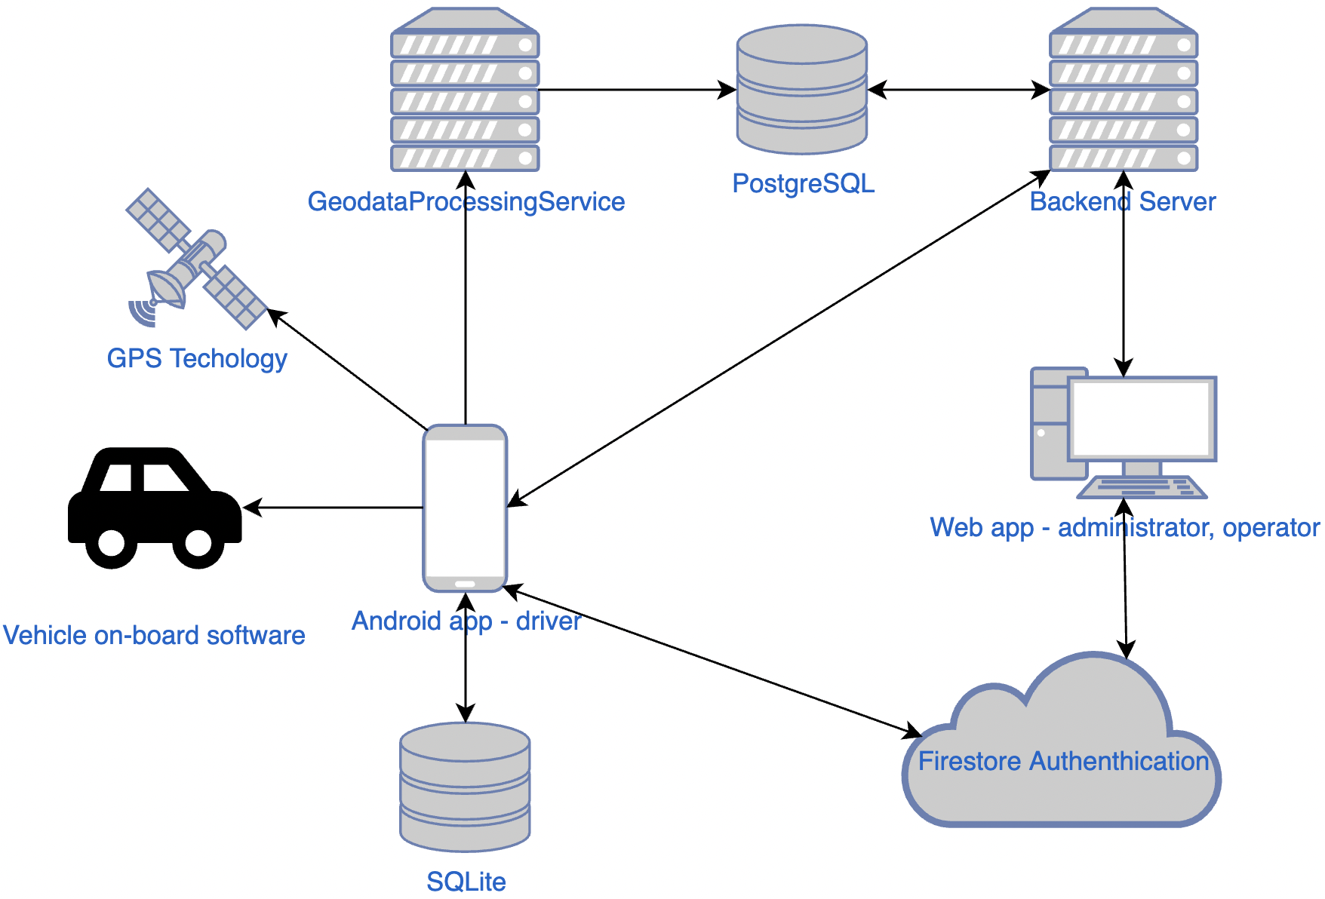
Alternative solution: service architecture
фото
Notes:
Service functionality is divided by four parts.
Android application is the service part used by vehicle drivers. Android application by default have access to the GPS technology – that’s enough for the MVP, but not enough to compete with market dominants, therefore additional on-board software Bluetooth adapter is needed, this way application will have access to fuel level, mileage and other metrics. Android application will be recording these vehicle data at given time interval to local SQLite database and then send these data to something called Geodata Processing Service. Application will also have functionality of driver’s task management and chat with the system operator.
Mentioned Geodata Processing service main purpose is to receive vehicles data from Android devices and store it at the server’s database. Service is divided from main backend server in order to split the load on the backend.
Backend service is responsible for the providing API to manage, aggregate and return the rest of system data from the databse. In general, its functionality is close to functionality of market dominants: management of vehicles and drivers, return of vehicle data for further visualization, driver tasks, export of analytical reports and providing data for the dashboard with statistics over the vehicle fleet, set parameters for Android application such as time interval between recordings and others.
Frontend part of web application serves system operators and administrators to manage and analyze vehicle fleet data. It integrates with Firebase Authentication service for authentication and with Google Maps API [5] for visualizing vehicle data on the map.

Slide 8
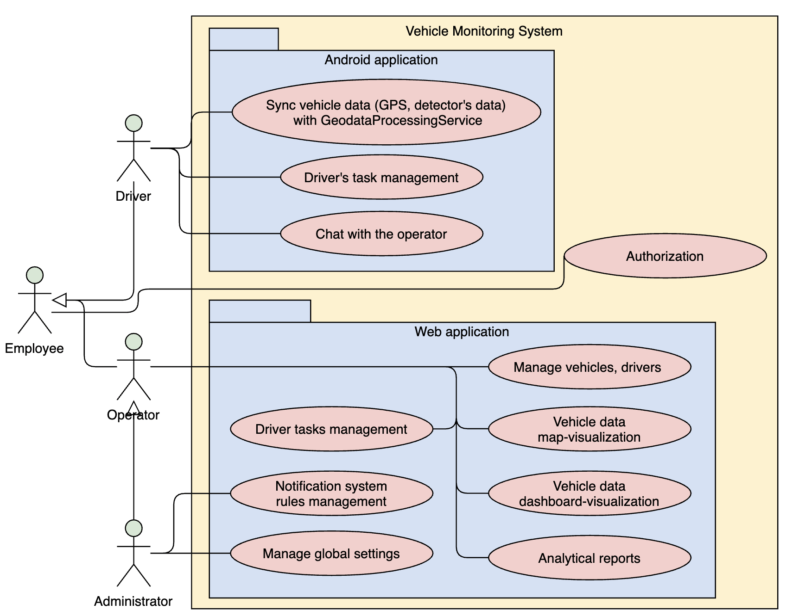
Alternative solution: functionality
фото
Notes:
Service target customers are companies, which business relay on vehicle fleet. Commonly these companies have following roles structure: drivers, operators and administrators.
Drivers are employees who are in charge of vehicles driving. Driver utilize Android application for sending vehicle’s location and other vehicle related data to the Geodata Processing Service, he can manage tasks assigned to him and communicate with the operator by chat.
Operator responsibility is to manage system related data (vehicles, drivers, tasks), analyze fleet state with the help of visualizations and analytical reports.
Administrator is the role for company-wide system customization: managing operators, managing rules for the notification system, global settings as frequency of vehicle data retrieval and its synchronization.

Slide 9




Development technologies and tools
Web backend
Web frontend
Android application
фото
фото
фото
Version control
& issue tracking system
Authentication & messaging services
Hosting
DB
фото

Slide 10
Expected outcome
The concept of using an Android application instead of a GPS tracker device was confirmed - it was possible to connect the application to the car's on-board software in order to obtain various information: for example, about fuel consumption
A competitive vehicle monitoring system has been developed with functionality at least as listed in the functional requirements
фото
Notes:
The expected outcome of my diploma is the following:

Slide 11
References
Vehicle Tracking Systems Market Size [Online] / Available: https://www.grandviewresearch.com/industry-analysis/vehicle-tracking-systems-market , [Accessed Feb. 18, 2021].
Vehicle Tracking Device Market Statistics [Online] / Available: https://www.gminsights.com/industry-analysis/vehicle-tracking-market , [Accessed Feb. 18, 2021].
Verma P. and Bhatia J. S. (2013). “Design and development of GPS-GSM based tracking system with Google Map based monitoring”. June 2013. [Online] / Available: https://pdfs.semanticscholar.org/c19f/c9aa2d5d57139ac75869 aa12d113f3e288a2.pdf [Accessed Feb. 18, 2021].
Leonid Losich “Infographic: 2,500,000 units on Wialon in figures”. 6, November 2020. [Online] / Available: https://gurtam.com/en/blog/wialon-units-infographic [Accessed Feb. 18, 2021].
фото
фото
фото
Higher school of Economics, Moscow, 2021

Slide 12

Thank you for
your attention!
Sergey Roytman
siroytman@edu.hse.ru
Moscow - 2021

